Slide 1

The Evolution of Brain Based Therapy.
BrainCore
Therapy

Slide 2
BRAINCORE IS A UNIQUE NEUROFEEDBACK SYSTEM
Cutting edge technology that is setting a new standard in triggering the brains ability to form new connections in response to experience
New connections mean new neural pathways that can now be activated to help overcome symptoms associated with many neurological conditions
ADHD Migraine/Tension Headache
Insomnia Chronic Pain
Anxiety Stress Disorders

Slide 3
WHAT IS NEUROFEEDBACK
Neurofeedback is a science
A training method based on operant conditioning
The patient is rewarded for producing a certain brainwave
The reward may be visual, auditory or tactile
The patient eventually learns how to control the production of the brainwave voluntarily
This results in the alleviation of neurological symptoms

Slide 4
Neurofeedback is like learning to ride a bike
If a parent explains to a child how to ride a bike, that child would still not be able to ride one.
The mind’s knowledge does not always translate into information for our brain
Or brain learns from experience, and we do that with the help of feedback

Slide 5
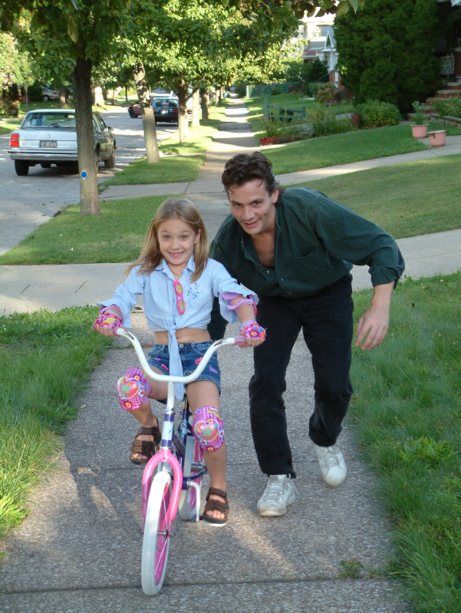
In this case, gravity is the feedback

Slide 6


Sometimes tools can assist the learning process such as using training wheels
Eventually the brain develops new neural connections that translates into look mom, I can do it

Slide 7

Just as you always remember how to ride a bike, improvements made with neurofeedback are permanent

Slide 8
THE RESEARCH
In fact, Dr Frank H. Duffy, a Professor and Pediatric Neurologist at Harvard Medical School, stated that “Neurofeedback should play a major therapeutic role in many difficult areas. In my opinion, if any medication had demonstrated such a wide spectrum of efficacy it would be universally accepted and widely used”

Slide 9
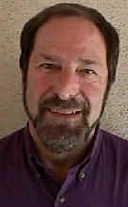
THE STERMAN STUDIES

Slide 10
BARRY STERMAN
Barry Sterman, PhD. was a sleep researcher who stumbled upon the miracle of neurofeedback during one of his experiments involving cats back in 1965.
His work eventually lead to the discovery of a neurofeedback protocol that is still used today to treat grand mal seizures in epileptics.
Braincore incorporates these same protocols into the BrainCore proprietary software

Slide 11
THE STERMAN STUDIES
After Barry Sterman received his PhD at UCLA in neurology and psychology, he accepted a position as a sleep researcher at the Veterans Hospital in Los Angeles.
Sterman set out to answer whether a person chose to go to sleep at night or the brain imposed sleep upon us.
Prior work by Pavlov indicated that it was a choice

Slide 12
THE STERMAN STUDIES
Sterman set out to replicate Pavlov’s studies only this time while using an EEG to observe the brainwaves
Sterman began his study with 30 cats
All of the cats were connected to an EEG so that Sterman could observe their brainwaves during the experiment

Slide 13
THE STERMAN STUDIES
First the cats were conditioned to press a lever to get a reward of milk and broth
During this initial phase of the experiment nothing unusual was observed on the EEG
He then introduced a tone – if the cat pushed the lever while the tone was sounded the milk would not be delivered. - The cat had to wait until the tone stopped

Slide 14

To the surprise of the researchers, the cats entered a unique state after this variable was introduced
The cats remained absolutely still but extremely alert, waiting for the tone to finish – the same state a cat enters while hunting in the wild.

Slide 15
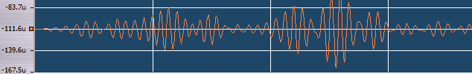
THE STERMAN STUDIES
During this time of motor stillness Sterman observed a new brain wave that had never been seen before – he called this new brainwave Sensorimotor Rhythm or SMR

Slide 16
THE STERMAN STUDIES
He carried the experiment one step further
Could the cat be operantly conditioned to create this specific frequency of brain waves on its own?
No lever was used – instead the cat was hooked to an EEG and whenever the cat produced a ½ second burst of SMR the cat was given the milk.

Slide 17
THE STERMAN STUDIES (1965-1967)
Sterman trained 10 cats to produce SMR at will
He reproduced the results with 8 rhesus monkeys and published his findings in the journal Brain Research in 1967
But he still did not understand the practical implications of this discovery

Slide 18
THE STERMAN STUDIES (1965-1967)
Unrelated to his study, NASA requested that Sterman study the effects of human exposure to hydrazine (rocket fuel)
He injected 50 cats with hydrazine – 40 of the cats developed seizures 1 hour after being injected
The 10 cats from the previous SMR experiment did not develop seizures

Slide 19
THE STERMAN STUDIES (1965-1967)
Sterman came to realize that by teaching the cats to produce SMR in the previous experiment, he strengthened their brain function.
The cat’s seizure threshold had been increased, the brains were now functionally altered so as to prevent the seizures.
These studies clearly demonstrated that the effects of neurofeedback were clearly physiological and not placebo.

Slide 20
THE STERMAN STUDIES (1965-1967)
Sterman began training epileptics to produce SMR using neurofeedback
He was able to demonstrate a 70% reduction in grand mal seizures and published his findings in Epilepsia in 1978

Slide 21

Joel Lubar
Joel Lubar, PhD. built on Barry Sterman’s work to develop the protocol for ADD/ADHD that is still used today in the Braincore protocol for ADD/ADHD.
Over 100 published articles
More than 25 studies showing the efficacy of neurofeedback for ADHD

Slide 22
BRAINWAVES A Window to the Brain

Slide 23
BRAIN WAVES
There are 5 primary brainwaves:
Delta Waves
Beta Waves
Theta Waves
Alpha Waves
Sensorimotor Rhythm

Slide 24
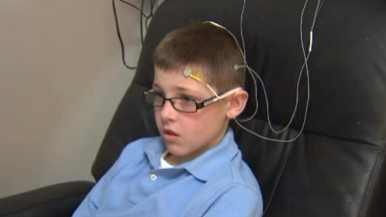
Electroencephalograph
A noninvasive diagnostic tool that allows us to measure the different brainwaves. As such, it provides a window to the brain and how well it is functioning.

Slide 25
BRAINWAVES
Brainwaves tell us how different areas of the brain are communicating.
Each of the 5 different brainwaves is associated with a particular state of mind.
For example, when you brain is externally focused and alert, the brain is producing beta waves. When your brain is calm and relaxed it is producing alpha waves.

Slide 26
BRAINWAVES AND MENTAL STATES

Slide 27
DELTA WAVES
Delta waves are produced during stages of deep sleep and they are associated with the production of Human Growth Hormone which is necessary for growth, healing and tissue repair.
If a person’s brain is unable to produce delta waves, then a deficiency of Human growth hormone may result.
This can lead to conditions such as fibromyalgia, tension headache, migraine headache, insomnia, and chronic pain.

Slide 28
THETA WAVES
Theta waves are associated with a twilight state of mind. These waves are produced when your brain is falling asleep.
These waves are associated with memory retrieval and creativity.
However, when they are produced at inappropriate times, such as when a child is trying to concentrate in class, these waves may be associated with inattention and lack of focus.

Slide 29
THETA WAVES
Over 25 different research studies have demonstrated that children and adults with ADHD produce unusually high levels of this wave.
It has been suggested that measuring Theta wave levels is the most accurate method for diagnosing ADHD.

Slide 30
ALPHA WAVES
Alpha waves are also known as the meditative brain wave. This is because when a person meditates the brain waves shift to alpha.
Alpha is associated with relaxation, calmness and a sense of wellbeing. Alpha is also associated with the ability of the brain to enter deep sleep.

Slide 31
ALPHA WAVES
If a person’s brain produces unusually low levels of alpha then it will be impossible to enter delta sleep – a disorder known as insomnia.
This finding has also been linked to conditions such as hyperactivity, migraine headache, tension headache, fibromyalgia.

Slide 32
SENSORIMOTOR RHYTHM (SMR)
These are the brain waves that are produced when a person is completely still and focused on one particular task.
The Olympic high diver standing atop his diving board just before the dive, or the golfer standing perfectly still just before his swing are just two examples of when the brain is producing SMR waves.

Slide 33
SENSORIMOTOR RHYTHM (SMR)
The ability of the brain to produce high levels of SMR has been linked to decreased hyperactivity and an increased resistance to seizures.
Several studies have shown that increasing levels of SMR may reduce grand mal seizures in epileptics by 70%.
In addition, teaching a person to produce more SMR can help alleviate symptoms associated with ADHD

Slide 34
BETA WAVES
The brain produces beta waves when the individual is alert and externally focused.
Established research studies have demonstrated that children and adults suffering from ADHD produce unusually low levels of beta waves.

Slide 35
BETA WAVES
This finding may help explain why these patients are unable to stay focused on certain tasks.
On the other hand, if the brain produces too many of these beta waves the individual may become hyperactive and anxious.

Slide 36
SUMMARY OF BRAIN WAVES AND MENTAL STATES
Delta Waves – Deep Sleep, Human Growth Hormone Production
Theta Waves – Twilight
Alpha Waves – Meditation, Health
SMR – Extremely alert and perfectly still
Beta Waves – Problem Solving, Focused, Alert

Slide 37
NEUROLOGICAL DYSREGULATION
DYSREGULTAION OF
BRAIN WAVE PATTERNS

Slide 38
NEUROLOGICAL DYSREGULATION
Neurological Dysregulation refers to the inability of the brain to regulate itself.
This results in miscommunication within the brain and the production of abnormal or atypical brain wave patterns.

Slide 39
NEUROLOGICAL DYSREGULATION
This condition may be caused by poor nutrition, emotional or physical trauma or stress, drugs and toxins, or a subluxated spine.
Neurological Dysregulation is associated with ADHD, Migraine and Tension Headache, Insomnia, Fibromyalgia and Chronic pain as well as many others.
It has also been shown to be a factor in Parkinson’s, autism and Asperger’s syndromes.

Slide 40
DYSREGULATED PATTERNS AND ASSOCIATED CONDITIONS

Slide 41
CONDITIONS RELATED TO DYSREGULATED PATTERNS
Each Condition has an associated Dysregulated Pattern of brain wave activity
The initial Braincore EEG evaluation will identify these dysregulated patterns

Slide 42
ADHD
Over 30 years of university based research has demonstrated that the brains of children and adults suffering with ADHD produce too many theta waves and too few beta waves resulting in an ability to concentrate and pay attention.
In some cases the individual may become hyperactive to compensate for the lack of focus.

Slide 43
ADHD
BrainCore Therapy is a drugless, noninvasive procedure designed to reverse this abnormal brainwave pattern through neurofeedback training and reduce or eliminate the symptoms associated with ADHD.

Slide 44
MIGRAINE / TENSION HEADACHES
The brainwave pattern of people suffering with headaches typically demonstrates low levels of alpha waves and high levels of beta waves.
This pattern causes the brain to become hyperactive, making it more susceptible to environmental triggers that spark the onset of a headache.

Slide 45
MIGRAINE / TENSION HEADACHES
BrainCore Therapy is a drugless, noninvasive procedure designed to reverse this abnormal brainwave pattern and reduce or eliminate headaches by calming the brain making it less susceptible to triggers.

Slide 46
INSOMNIA
Studies show an increased mortality risk for those reporting less than either six or seven hours per night.
One study found that reduced sleep time is a greater mortality risk than smoking, high blood pressure, and heart disease.

Slide 47
INSOMNIA
BrainCore Therapy is a drugless, noninvasive procedure designed to reverse the abnormal brainwave pattern associated with insomnia thereby allowing the brain to comfortably move into deep sleep and reduce the risk of developing a serious medical condition.

Slide 48
CHRONIC PAIN AND FIBROMYALGIA
Research out of Canada in the mid 1970’s demonstrated that these conditions are linked directly to an inability to produce delta waves during deep sleep states.
This irregular pattern of brainwave activity results in the conditions known as Fibromyalgia and chronic syndrome.

Slide 49
CHRONIC PAIN AND FIBROMYALGIA
BrainCore Therapy is a drugless, noninvasive procedure designed to reverse the abnormal brainwave pattern associated with fibromyalgia and chronic pain allowing the brain to enter delta sleep and eliminate the symptoms associated with these debilitating conditions.

Slide 50
OTHER CONDITIONS RELATED TO DYSREGULATED PATTERNS
Autism and Asperger’s Syndrome
Depression
Learning Disorders
Dyslexia
Tics
Tourette's Syndrome

Slide 51
OTHER CONDITIONS RELATED TO DYSREGULATED PATTERNS
Memory Loss
Chronic Fatigue Syndrome
Some cases of Traumatic Brain Injury
Some cases of paralysis
Panic and Anxiety Disorders
Post Stroke Syndrome

Slide 52
POSSIBLE CAUSES OF DYSREGULATED PATTERNS
Subluxation
Emotional and/or Physical Stress
Trauma
Drugs / Toxins
Poor Nutrition

Slide 53
BRAINCORE THERAPY
The BrainCore Neurofeedback System:
Training the brain to produce normal brain wave patterns

Slide 54
THE BRAINCORE TRAINING SESSIONS
EEG Report is correlated with patient symptoms and protocol is selected
Neurofeedback sessions are begun
Feedback may be in the form of:
DVD
Pac Man
Puzzle
And others

Slide 55
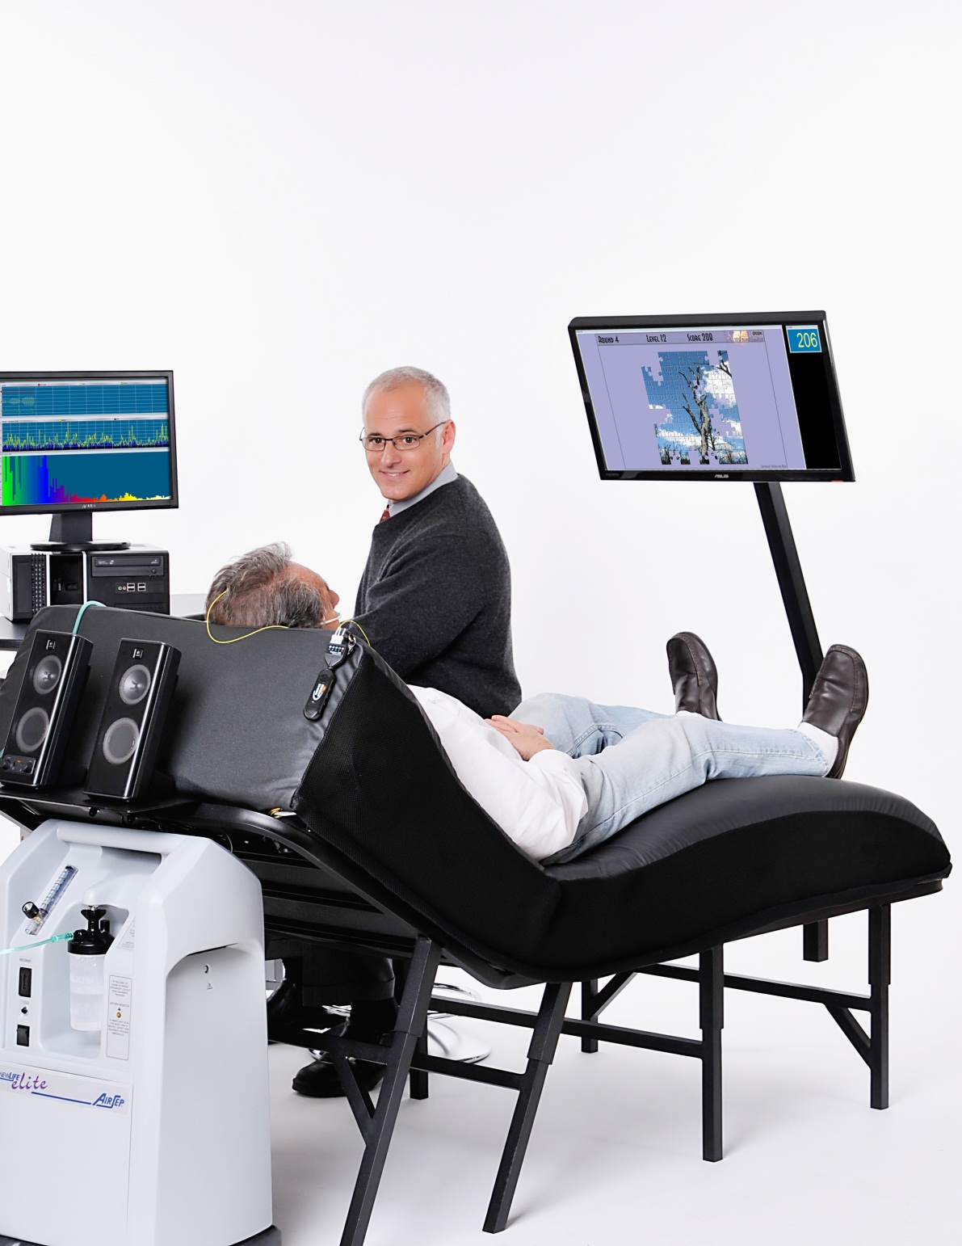
Notes:
Describe the procedure using this diagram

Slide 56
TESTIMONIALS
www.braincoretherapy.com

Slide 57
A SPECIAL GIFT FOR ATTENDING
Complimentary BrainCore EEG Evaluation

